Slide 1

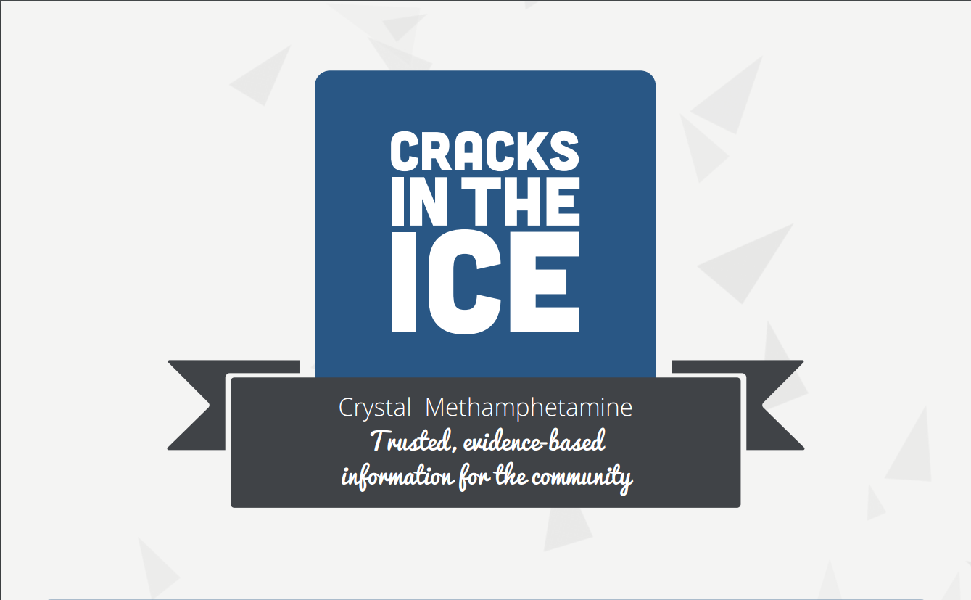
Cracks in the ice
@cracksintheice
cracksintheice.org.au
Notes:
Today we are going to go through some information about ice (also known as crystal methamphetamine). The information in this PowerPoint has been adapted from the Cracks in the Ice community toolkit, and companion booklet. For more detailed information, you can visit the website on the screen, subscribe to email updates, or connect with Cracks in the Ice through Facebook and Twitter.
Recent studies show that approximately 1 in 75 Australians have used some form of methamphetamine, like ice, in the past year. However, we know that the rates of use in some communities are higher than this, and that ice not only affects the person using the drug but can have devastating effects on their loved ones.

Slide 2




PRESENTATION OVERVIEW
What is ice?
Why do people use ice?
How does ice work?
Families and Friends: How can I support a loved one?
Resources for Health Workers: Do’s and Don’ts
Schools: Tools for Parents
When and where do I get help?
What type of help is available?
Notes:
This talk doesn’t aim to cover every fact about ice (crystal methamphetamine), but it’s a good opportunity to start learning. Here is a summary of what we will look at today:
[refer to the list on the screen].

Slide 3
WHAT IS ICE?
Ice, also known as Crystal Methamphetamine.
Methamphetamine typically comes in three main forms – ice, base and speed.
Ice is the most potent and pure form of methamphetamine.
WHAT IS ICE?
Notes:
Ice is also known as crystal methamphetamine.
Methamphetamine typically comes in three main forms – ice, base and speed.
The infographic on the right shows that ice is the most potent form of methamphetamine, meaning it has the most dramatic effects. It gives a stronger and longer lasting “high”, and more serious “comedown” side-effects. We will talk more about the effects of ice in the coming slides.

Slide 4

WHY DO PEOPLE USE ICE?
Common reasons for ice use include:
To fit in/feel part of a social group
To reduce inhibitions and increase confidence
Out of curiosity or to experiment
To manage mental health issues and the impacts of trauma
To cope with problems (e.g. unemployment, stress)
To escape reality
Out of boredom
To enhance work performance
To enhance sexual experiences
and intimacy
Although many people report that they use ice to feel more confident or lift their mood, in reality taking methamphetamines like ice often increases nervousness, agitation, and can trigger anxiety attacks.
WHY DO PEOPLE USE ICE?
Notes:
There is no single reason why people use ice. Usually several things act in combination.
Here are just some of the reasons someone may start to use ice [refer to the list on the screen].
What’s important to note is that although many people report that they use ice to feel more confident or lift their mood, in reality taking methamphetamines like ice often increases nervousness, agitation, and can trigger anxiety attacks.

Slide 5

HOW DOES ICE WORK?
Ice triggers the release of brain chemicals (or neurotransmitters): dopamine, serotonin and noradrenaline.
These chemicals are responsible for making us feel excited, alert and euphoric.
However, consistent and heavy use of ice can deplete these chemicals.
Prolonged use of ice can also damage or destroy the receptors for these chemicals in the brain.
HOW DOES ICE WORK?
Notes:
Ice triggers the release of two chemicals in the brain (also known as neurotransmitters) called dopamine and noradrenaline. These chemicals, which are responsible for making us feel excited, alert and euphoric, can be depleted by consistent and heavy use of methamphetamines like ice. Prolonged use can also damage or destroy the receptors for these chemicals in the brain — sometimes to a point where the person using the drug no longer feels normal without having ice in their system.

Slide 6
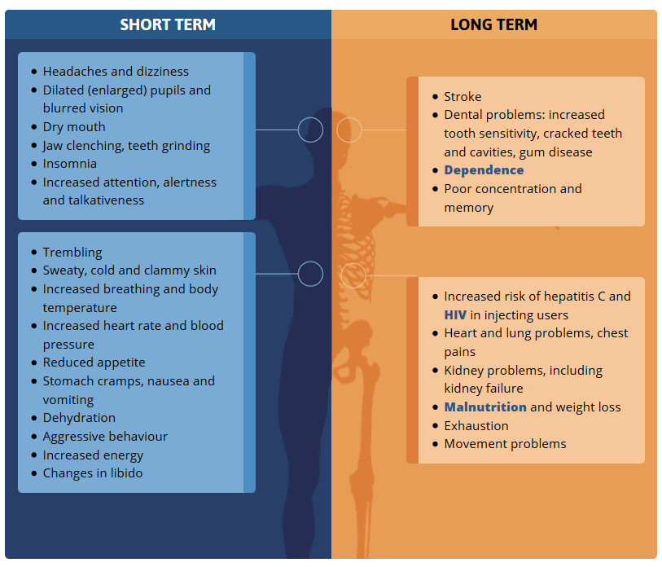
PHYSICAL EFFECTS
The physical effects of ice can last between 4 and 12 hours, although it can take 1 to 2 days for ice to entirely leave the body.
Using methamphetamines can also increase mortality risk related to overdose, natural diseases, suicide and accidental injury.
Notes:
The effects of ice can be long lasting, often persisting for between 4 and 12 hours depending on how much ice is consumed. Although the effects of ice can usually be felt quickly, it can take 1 to 2 days to entirely leave the body. Some of the physical effects of ice are listed in the infographic [allow time for audience to look, or presenter can read through some of these].

Slide 7
COME DOWN AND WITHDRAWAL SIDE-EFFECTS
THE COMEDOWN PHASE is experienced when ice starts to wear off.
Feeling down or depressed
Decreased appetite
Exhaustion
Increased need for sleep
Irritability
Feeling anxious
WITHDRAWAL refer to unpleasant symptoms experienced by people who are dependent on ice:
Headaches
Anxiety
Aggression
Restlessness
Cramps
Vomiting
Notes:
A ‘comedown’ or ‘crash’ phase is often experienced as the drug starts to wear off. These feelings can last a few days and symptoms can include [refer to the list on the slide].
Withdrawals refer to unpleasant symptoms experienced by people who are dependent on ice. Depending on the severity of dependence, these symptoms can last for several days or weeks, and can include [refer to the list on the slide].

Slide 8
MENTAL HEALTH EFFECTS
For some people, the symptoms experienced while using ice, or during the ‘comedown’ or ‘crash’ phase, persist and develop into mental disorders in their own right.
MENTAL HEALTH EFFECTS
Notes:
The mental health effects of ice use are listed on the infographic [allow time for audience to look, or presenter can read through some of these]. For some people symptoms experienced while using the drug, or during the ‘comedown’ or ‘crash’ phase, persist and develop into mental disorders in their own right.

Slide 9
MENTAL HEALTH EFFECTS
Below are common side effects of ice use, however, if these effects persist, a mental illness may be present.
SIGNS OF ANXIETY:
Restlessness
Trembling
Dizziness
Sweating
Dry mouth
Muscle aches
Headaches
Nausea
Vomiting.
SIGNS OF DEPRESSION:
People who use the drug regularly can experience depressive symptoms when they are not using ice because it can deplete brain chemicals which are responsible for making us feel happy and excited.
SIGNS OF PSYCHOSIS:
Feeling suspicious or paranoid
Hallucinations
Unusual thoughts
Repetitive compulsive behaviour
Muddled thoughts or incoherent speech.
Notes:
Here are common side effects of ice use, however, if these effects persist, a mental illness may be present.
Anxiety: Methamphetamine increases heart rate which can cause people using the drug to feel short of breath and trigger panic attacks. Other common symptoms include restlessness, trembling, dizziness, sweating, dry mouth, muscle aches, headaches, nausea or vomiting.
Depression: As the effects of methamphetamine begin wearing off, it is common to feel very low for a few hours or even up to a few days. People who use the drug regularly can experience depressive symptoms when they are not using the drug because it can deplete brain chemicals which are responsible for making us feel happy and excited. If these symptoms persist it may be a sign that depression is present.
Psychosis: Heavy, consistent use of methamphetamines like ice can cause acute psychotic reactions in some people. These symptoms can last a few hours or up to a few days. They include:
Feeling suspicious or paranoid
Hallucinations (hearing, seeing or smelling things that don’t exist)
Unusual thoughts (e.g. thinking other people are reading your mind or stealing your thoughts)
Repetitive compulsive behaviour
Muddled thoughts or incoherent speech
A small number of people may find these symptoms last much longer (e.g. more than a few weeks) or continue even when a person is not using ice. If these symptoms persist it may be a sign that an underlying psychotic disorder, such as schizophrenia, is present.

Slide 10
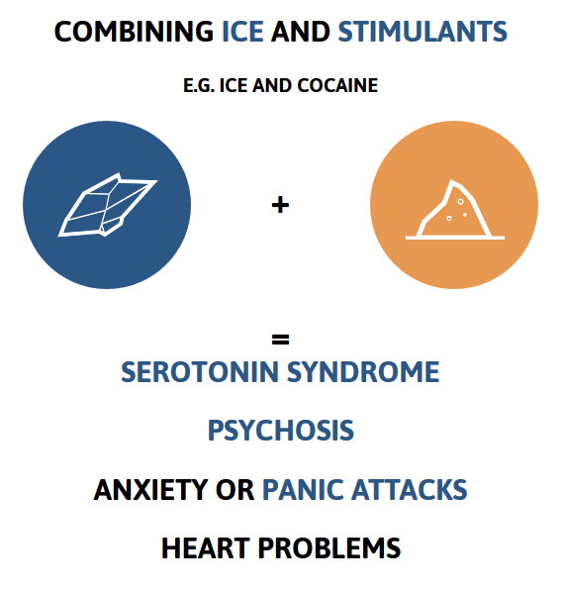
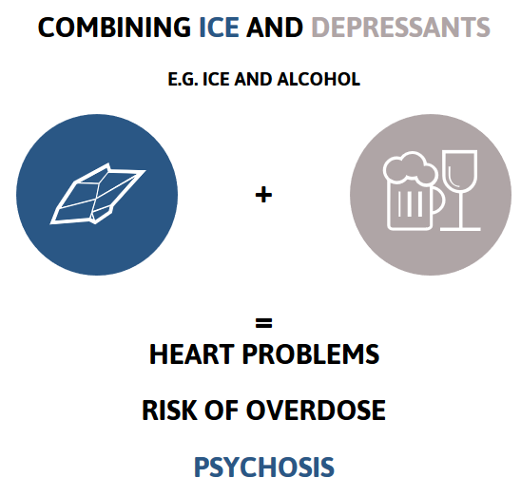
WHAT HAPPENS WHEN YOU USE ICE WITH OTHER DRUGS?
Combining ice with other drugs carries extra risks and makes its use even more dangerous. The more drugs a person takes (or is affected by) at a time, the more chance there is of something going wrong.
USING ICE WITH OTHER DRUGS
Notes:
Combining ice with other drugs carries extra risks and makes its use even more dangerous. The more drugs a person takes (or is affected by) at a time, the more chance there is of something going wrong.
The infographics reveal some of the risks of using ice with stimulants or depressants.
Using ice with stimulants (e.g. cocaine) can increase the risk of cardiovascular (heart) problems and substance-induced psychosis. People mixing these drugs can also increase their risk of experiencing serotonin syndrome, anxiety or panic attacks.
Using ice with stimulant medications (e.g. Ritalin) can increase the risk of anxiety and panic attacks, heart problems and substance-induced psychosis. Using ice with some types of anti- depressants can increase the risk of serotonin syndrome, especially among people that are on a Selective serotonin reuptake inhibitor (SSRI) antidepressant.
Using ice with depressants such as alcohol, cannabis, heroin or benzodiazepines (‘depressants’) places extra strain on the heart which may lead to serious complications, especially among people with pre-existing heart problems. Using ice with cannabis can increase a persons’ risk of experiencing mental health problems, including psychotic symptoms, especially in those who have existing mental health problems.

Slide 11
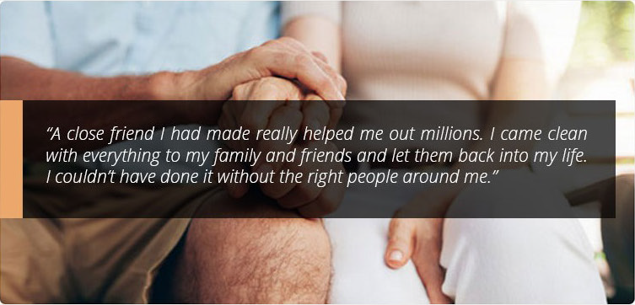
HOW CAN I SUPPORT A LOVED ONE?
I WANT TO START THE CONVERSATION – HOW CAN I RAISE THE ISSUE?
Notes:
In addition to providing general information about ice and its effects, the Cracks in the Ice community toolkit also has more targeted resources for many groups of people who are affected by ice use in Australia. These groups include family and friends of people who use ice, health professionals, local communities and schools.
The family and friends section of Cracks in the Ice provides information on how to support a loved one who is using ice and where family and friends can go for support. One of the most frequently asked questions is how to start the conversation about ice use.

Slide 12
HOW CAN I SUPPORT A LOVED ONE?
I WANT TO START THE CONVERSATION – HOW CAN I RAISE THE ISSUE?
Tips for starting a conversation about ice and other drugs:
Gather information about ice.
Have a clear idea of what it is that concerns you about ice.
Arrange a suitable time to talk when you will have some privacy.
Ask questions; don't make assumptions about their knowledge of ice.
Don't tell them what to do and try not to be judgemental.
Let them know you care about them.
Be trustworthy and supportive so they know that they can rely on you in a time of need.
STARTING THE CONVERSATION
Notes:
Starting the conversation about a loved one's ice use can be tricky. Having that initial conversation may not meet all of your expectations and resolve everything but can be critical in setting the scene for further conversations in which you are considered a trusted confidant.
Here are some tips for starting a conversation when you are concerned about a loved one’s ice use.
Gather information to make sure you understand what ice is and its effects.
Have a clear idea of what it is that concerns you about ice.
Arrange a suitable time to talk when you will have some privacy and you won't be interrupted.
Ask what they know about ice; don't make assumptions about their knowledge of the drug.
Don't tell them what to do and try not to be judgemental.
Let them know you care about them. People will be more likely to listen and engage in conversation if they feel valued and respected.
Be trustworthy and supportive so they know that they can rely on you in a time of need. Make sure they know your conversation will be kept confidential.

Slide 13

RESOURCES FOR HEALTH PROFESSIONALS
QUICK TIPS FOR MANAGING AND WORKING WITH CLIENTS
Example: DO’S AND DON’TS OF MANAGING ANGER AND AGGRESSION
Notes:
The Cracks in the Ice online toolkit also contains a lot of resources for Health Professionals including “Quick Tips” for managing and working with clients. An example of one of the quick tips is “Do’s and Don’t of Managing Anger and Aggression”.
Use of ice can increase paranoid and irrational thoughts, mood swings, and irritability, amongst many other side effects. Although not everyone who uses ice will become violent or aggressive, these side effects can make some individuals more likely to exhibit violent behaviours. This is a key area of concern for health professionals working with people who use ice.
In general, episodes of aggression are usually triggered by a particular event, which may involve circumstances that have led the client to feel threatened or frustrated.

Slide 14
RESOURCES FOR HEALTH PROFESSIONALS
DO’S AND DON’TS OF MANAGING ANGER AND AGGRESSION
The following signs may indicate that a client could potentially become aggressive or violent:
Appearance
Physical activity
Mood
Speech
Worker's reaction.
Marel, C et al. (2016). Guidelines on the management of co-occurring alcohol and other drug and mental health conditions in alcohol and other drug treatment settings (2nd edition). Available at: comorbidityguidelines.org.au
Notes:
The following signs may indicate that a client could potentially become aggressive or violent:
Appearance: intoxicated, bloodstained, carrying anything that could be used as a weapon.
Physical activity: restless or agitated, pacing, standing up frequently, clenching of jaw or fists, hostile facial expressions with sustained eye contact, entering 'off limit‘ areas uninvited.
Mood: angry, irritable, anxious, tense, distressed, difficulty controlling emotions.
Speech: loud, swearing or threatening, sarcastic, slurred.
Worker's reaction: fear, anxiety, unease, frustration, anger.
If a client becomes aggressive, threatening or potentially violent, it is important for alcohol and other drug workers to respond in accordance with the policies and procedures specific to their service. It is also important for service providers to have knowledge of how to respond to challenging behaviour, including physical threats or actual violence.

Slide 15
DO’S AND DON’TS OF MANAGING ANGER AND AGGRESSION
DO
Stay calm and keep your emotions in check.
Adopt a passive and non-threatening body posture (e.g. hands by your side with empty palms facing forward, body at a 45 degree angle to the aggressor).
Let the client air his/her feelings and acknowledge them.
Ask open-ended questions to keep a dialogue going.
Be flexible, within reason.
Use the space for self-protection (position yourself close to the exit, don’t crowd the client).
Structure the work environment to ensure safety (e.g. have safety mechanisms in place such as alarms and remove items that can be used as potential weapons).
Make sure other clients are out of harm’s way.
DON’T
Challenge or threaten the client by tone of voice, eyes or body language
Say things that will escalate the aggression.
Yell, even if the client is yelling at you.
Turn your back on the client.
Rush the client.
Argue with the client.
Stay around if the client doesn’t calm down.
Ignore verbal threats or warnings of violence.
Tolerate violence or aggression.
Try to disarm a person with a weapon or battle it alone.
Marel, C et al. (2016). Guidelines on the management of co-occurring alcohol and other drug and mental health conditions in alcohol and other drug treatment settings (2nd edition). Available at: comorbidityguidelines.org.au
Notes:
Here are some “do’s and don’ts” tips to manage another person’s anger or aggression. [read through the points on the slide or allow the audience to read through these themselves].

Slide 16

TOOLS FOR PARENTS
I’M A PARENT – HOW CAN I REDUCE THE RISK OF ICE USE IN THE FAMILY?
TOOLS FOR PARENTS
Notes:
This is a parent tool taken from the Cracks in the Ice community toolkit.
As a parent or guardian, it is normal to feel responsible for your child’s life and the decisions they make. Research has shown there are many ways in which parents can minimise the chances that a young person will use illegal drugs, including ice, or experience harms from their use.

Slide 17
TOOLS FOR PARENTS
I’M A PARENT – HOW CAN I REDUCE THE RISK OF ICE USE IN THE FAMILY?
BE A ROLE MODEL
Avoid contradictions between what you tell them and what you do.
Try to find fun ways to deal with problems that don’t involve drugs.
2. BE INVOLVED IN THEIR LIVES
Show an interest in their hobbies and activities.
Spend time with your child regularly where you can give them your undivided attention.
If they go out, ask them about where they are going and who they are going with.
Restrict internet access to central areas in the house.
If you pick your child up from school or after school activities, be open to inviting their friends to your house.
Build a support network by getting to know your child’s parents.
Notes:
1. BE A ROLE MODEL
It’s important to set a good example, as your behaviour and attitude towards ice and other drugs can have a big influence on your child’s behaviour. Avoid contradictions between what you tell them and what you do and try to find fun ways to deal with problems that don’t involve drugs.
2. BE INVOLVED IN THEIR LIVES
Get involved and show an interest in their hobbies and activities. Aim to spend time with your child regularly where you can give them your undivided attention. One way of doing this is to set up a routine of having meals together or helping them with their homework. If they go out, ask them about where they are going and who they are going with and make this discussion a regular part of your conversation. Knowing who your child is with and where they are can help reduce risk. It’s also important to restrict internet access to central areas in the house. Peer influence exerts a huge effect on your child’s behaviour, so it is natural to want to help your child choose the right friends. If you pick your child up from school or after school activities, be open to inviting their friends to your house. You can also build a support network by getting to know their parents. If you have good reason to believe your child’s friends are involved in ice or other drugs, be prepared to support them to find a new set of friends by engaging them in some new activities.

Slide 18

TOOLS FOR PARENTS
3. ESTABLISH AND MAINTAIN GOOD COMMUNICATION
Encourage them to share their thoughts, feelings, and opinions.
Try not to lecture them, it is important to listen to their thoughts and concerns and offer help and support.
Try and make yourself somehow available most of the time.
Notes:
3. ESTABLISH AND MAINTAIN GOOD COMMUNICATION
Encourage them to share their thoughts, feelings, and opinions to show you value what they think. This will allow them to be honest and not just say what they think you want to hear. Try not to lecture them, it is important to listen to their thoughts and concerns and offer help and support. Try and make yourself somehow available most of the time. For example, make sure your child can contact you easily if they are at a party. And most importantly, let your child know that you are always ready and willing to talk and listen.

Slide 19
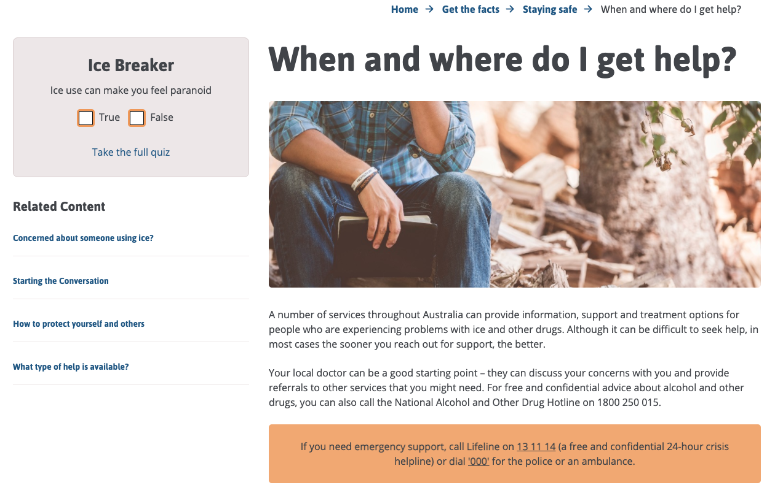
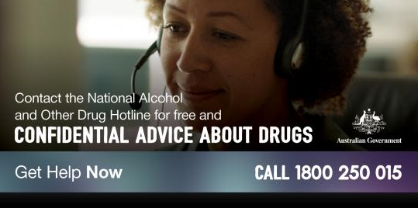
When and where do I get help?
The National Alcohol and Other Drug Hotline
Free and confidential advice about alcohol and other drugs
Support, information, counselling and referral to services
24 hour service
Ph: 1800 250 015
FOR OTHER HELP OPTIONS VISIT
WHEN AND WHERE DO I GET HELP
Notes:
For free and confidential advice about alcohol and other drugs in Australia, people can call the National Alcohol and Other Drug Hotline on 1800 250 015. It will automatically direct you to the Alcohol and Drug Information Service in your state or territory. These local alcohol and other drug telephone services offer support, information, counselling and referral to services.
A number of other services where you can find information and support, are also available on the Cracks in the Ice website on the When and where do I get help? page.

Slide 20
WHAT TYPE OF HELP IS AVAILABLE?
Seeing a Psychologist
Psychologists create a safe space for people to come and talk about things they might not feel comfortable talking about with families/friends.
They can assist people who are trying to understand their thoughts and feelings, and help them to learn skills and techniques to manage these thoughts and feelings.
Outreach Support
Outreach Support can be provided by a trained health professional who visits a person’s home to help them complete daily activities and supports them in tasks such as securing safe housing and attending health check-ups.
Online Treatment Programs
Online Treatment Programs can involve ‘chatting’ to a trained counsellor over the internet in real-time or by email, or a pre-programmed online “course” that is offered with or without support from a trained professional.
Residential Rehabilitation
‘Rehab’, ‘detox’ or ‘withdrawal’ clinics are places where people can stay for a few days or up to a few months at a time.
TYPES OF HELP
Notes:
This is a very brief summary of the help that is available for those experiencing problems with ice use. More detailed information about these services, and who is best suited to certain treatment options, is available in the Families and Friends section on the Cracks in the Ice website.
If you are unsure of which option is best for you or a loved one, your local doctor should be able to conduct an initial assessment and refer you to a service which fits your needs.
Psychologists create a safe space for people to come and talk about things they might not feel comfortable talking about with families/friends. They can assist people who are trying to understand their thoughts and feelings and help them to learn skills and techniques to manage these thoughts and feelings. For people who are ready, a psychologist can help with setting goals to encourage changes in a person’s life. A psychologist can deliver Cognitive Behaviour Therapy and Motivational Interviewing which are detailed on the Cracks in the Ice website.
Drug Counselling appointments can also be booked with a trained counsellor at a drug and alcohol service. Some services may also be able to help with concurrent mental health issues such as anxiety disorders and depression.
Outreach Support can be provided by a trained health professional who visits a person’s home to help them complete daily activities and supports them in tasks such as securing safe housing and attending health check-ups. They may also be trained in providing counselling support for both drug and mental health issues. This option is particularly suitable for people who are severely dependent on ice and unable to attend regular counselling appointments at a clinic due to housing or financial issues.
Online Treatment Programs can involve ‘chatting’ to a trained counsellor over the internet in real-time or by email, or a pre-programmed online “course” that is offered with or without support from a trained professional.
Residential Rehabilitation, such as ‘rehab’, ‘detox’ or ‘withdrawal’ clinics are places where people can stay for a few days or up to a few months at a time. The rehabilitation clinics provide accommodation, food and access to health professionals such as nurses and counsellors. These clinics often run daily activities such as education classes, exercise classes, movie sessions and gardening. Nurses and doctors can provide support for individuals experiencing withdrawal symptoms, and psychologists, counsellors or support workers assist with emotional difficulties during this time.

Slide 21

WANT MORE INFORMATION?
Visit the Cracks in the Ice community toolkit: cracksintheice.org.au for more information or to download a copy of the Cracks in the Ice companion booklet.
You can also keep updated by:
DOWNLOAD the app on iTunes and Google Play
SUBSCRIBE to the Cracks in the Ice email list and watch the webinars
LIKE Cracks in the Ice
FOLLOW @cracksintheice
Notes:
To find out more about ice and how the community can manage problems related to ice use together, go to the Cracks in the Ice website.
You can also keep up to date with Cracks in the Ice by downloading the mobile app, subscribing to the mailing list or following the team on Facebook and Twitter.

